Slide 1
INTRODUCTION TO PROGRAMMING LANGUAGE II (JAVA)
Fariha Zahin
Lecturer
CSE, Southeast University

Slide 2
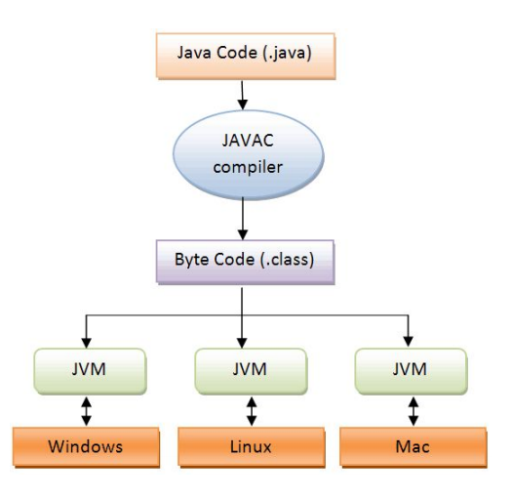
JAVA is a platform independent language:
It uses a virtual machine to execute.
Java Code: A developer writes Java code, which is compiled
into bytecode (represented as .class files)
Bytecode: The bytecode is platform-neutral, and it is shown
moving to the next stage.
JVM: The bytecode is processed by the Java Virtual Machine
(JVM). The JVM is the layer that ensures platform
independence. It translates the bytecode into native machine
code for each specific platform.
Platforms: the bytecode is translated into platform-specific
machine code for different operating systems, like
Windows, macOS, and Linux. Each platform would have the
appropriate JVM that runs the bytecode correctly.

Slide 3
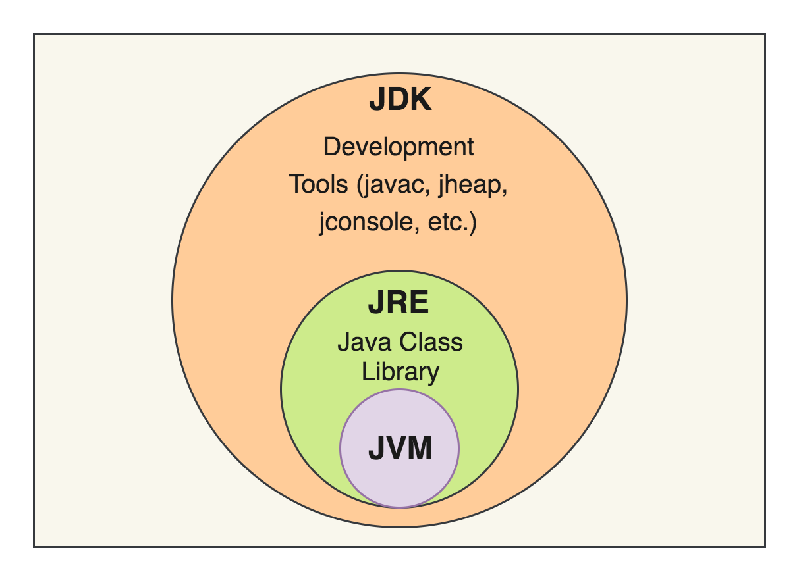
JVM (Java Virtual Machine)
Runs Java programs by converting bytecode into
machine code.
It’s platform-dependent (Windows, Mac, Linux have
different JVMs).
It ensures Java’s “Write Once, Run Anywhere” feature.
JRE (Java Runtime Environment)
Provides everything needed to run Java programs.
Includes JVM + libraries but not development tools.
Used for running Java applications only.
JDK (Java Development Kit)
Used for developing Java applications.
Includes JRE + JVM + development tools (compiler, debugger, etc.).
Required for writing and compiling Java code.

Slide 4
🎬 Scenario: Watching a Movie
Java Term | Movie Analogy | Role
JVM | Actor on stage | Runs the script (bytecode)
JRE | Movie theater | Environment to watch the movie (run Java apps)
JDK | Director's studio | Tools to create and edit the movie (write/compile Java apps)

Slide 5
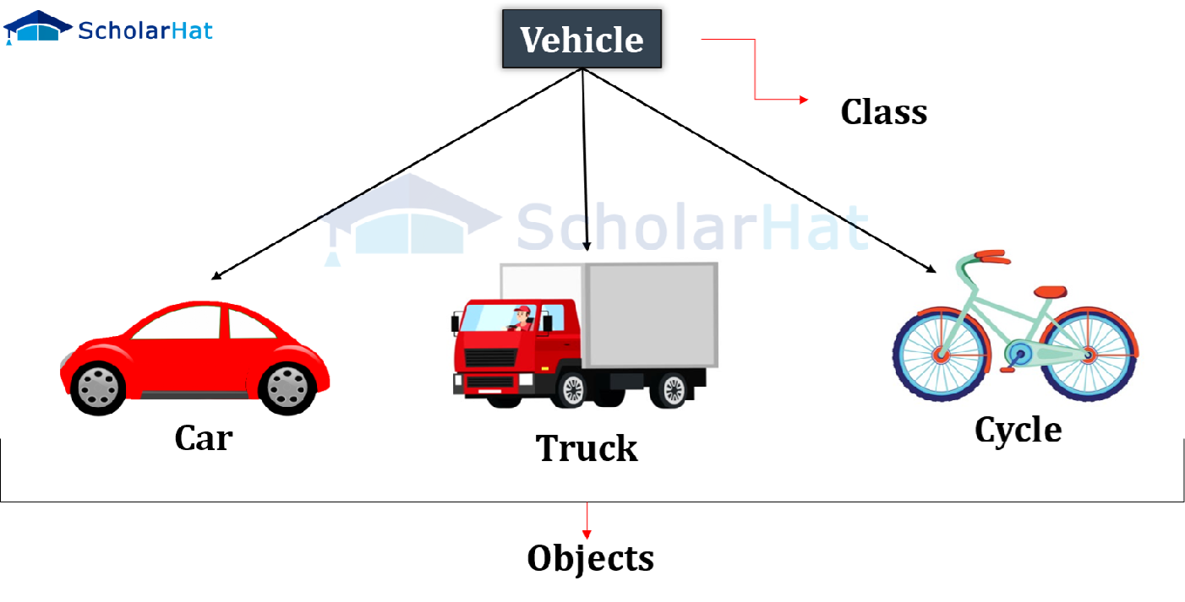
Class and Object in Java
Class:
A class is a template or blueprint for creating objects.
It defines attributes (variables) and behaviors (methods) but does not store actual data.
Object:
An object is an instance of a class.
It holds real values and performs actions as defined in the class.

